Slide 1
Stellar Nucleosynthesis

Slide 2
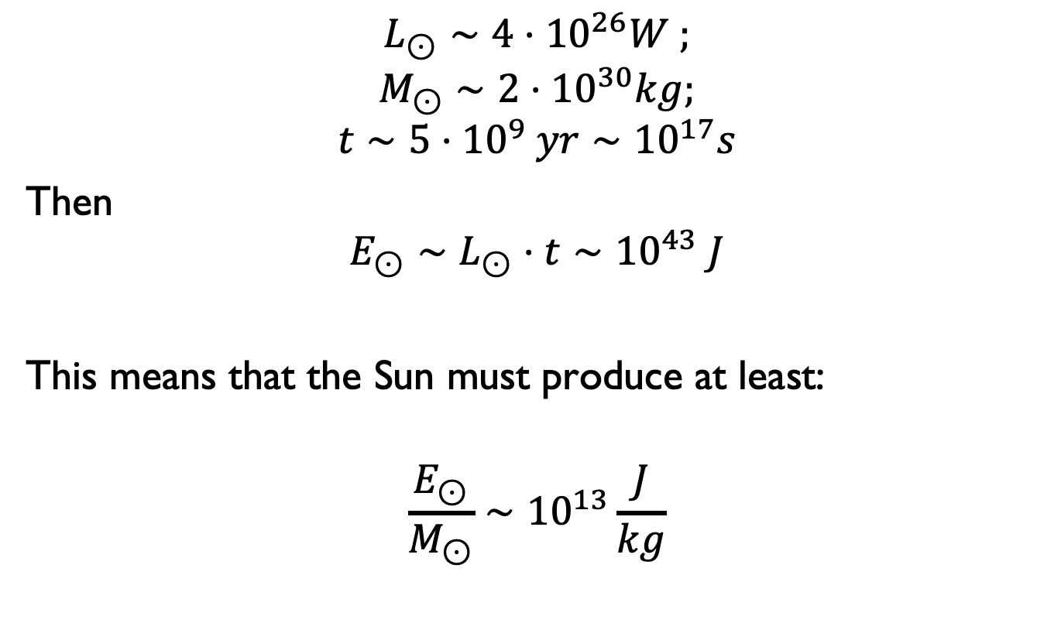
Required Energy
$$L_{⊙}∼4⋅{10}^{26}W ;$$
$$M_{⊙}∼2⋅{10}^{30}kg;$$
$$t∼{5⋅10}^{9} yr∼{10}^{17}s$$
Then
$$E_{⊙}∼L_{⊙}⋅t∼{10}^{43} J$$
This means that the Sun must produce at least:
$$\frac{E_{⊙}}{M_{⊙}}∼{10}^{13}\frac{J}{kg}$$

Slide 3
Produzione di energia
I possibili meccanismi di produzione di energia nelle stelle sono:
Energia Potenziale gravitazionale (energia prodotta nella contrazione della stella)
Energia Chimica (energia rilasciata quando gli atomi si combinano insieme un valore tipico è 10 eV)
Energia Nucleare (Energia rilasciata quando si forma un atomo)

Slide 4
Energy Production
Nuclear Energy Sources
The rest masses of the fundamental nuclear particles (for m=E(MeV)/c²):
Proton: m_{p} = 1.672623 × 10^{–27} kg = 938.28 MeV/c²
Neutron: m_{n} = 1.674929 × 10^{–27} kg = 939.57 MeV/c²
Electron: m_{e} = 9.109390 × 10^{–31} kg = 0.511 MeV/c²
For atoms the Atomic mass unit, 1 u = 1.660540 × 10^{–27} kg = 931.49432 MeV/c², is often used.
¹H = 1.673525 x 10⁻²⁷ kg = 938.78326 MeV /c² =1.007825 u

Slide 5

Binding Enengy
Nuclear fusion is the union of light nuclei to produce heavier nuclei. Nuclear fusion reactions are exothermic and are the principal source of energy in stars. Energy is emitted by these reactions because the nuclei that are produced are more stable than those that fuse.
The mass m_{nuc} of the nucleus is always found to be less than the combined mass of the protons and neutrons. It is the energy equivalent of this mass deficit which provides the binding energy of the nucleus and is given by (A= mass number (p+n); Z = Atomic number (p))
Which can be also defined as the minimum energy required to break up and disperse to infinity all the constituent nucleons in the nucleus.
To express how tightly bound a nucleus is, we need to consider the binding energy per nucleon: E_{B}/A

Slide 6
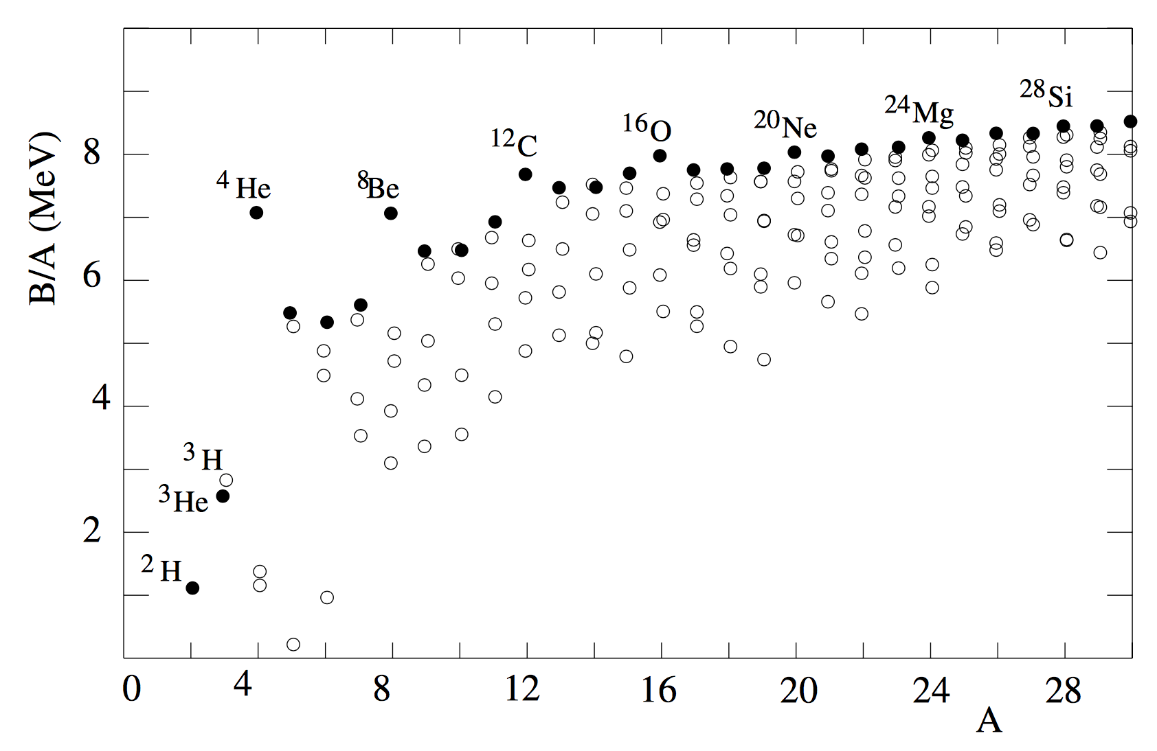
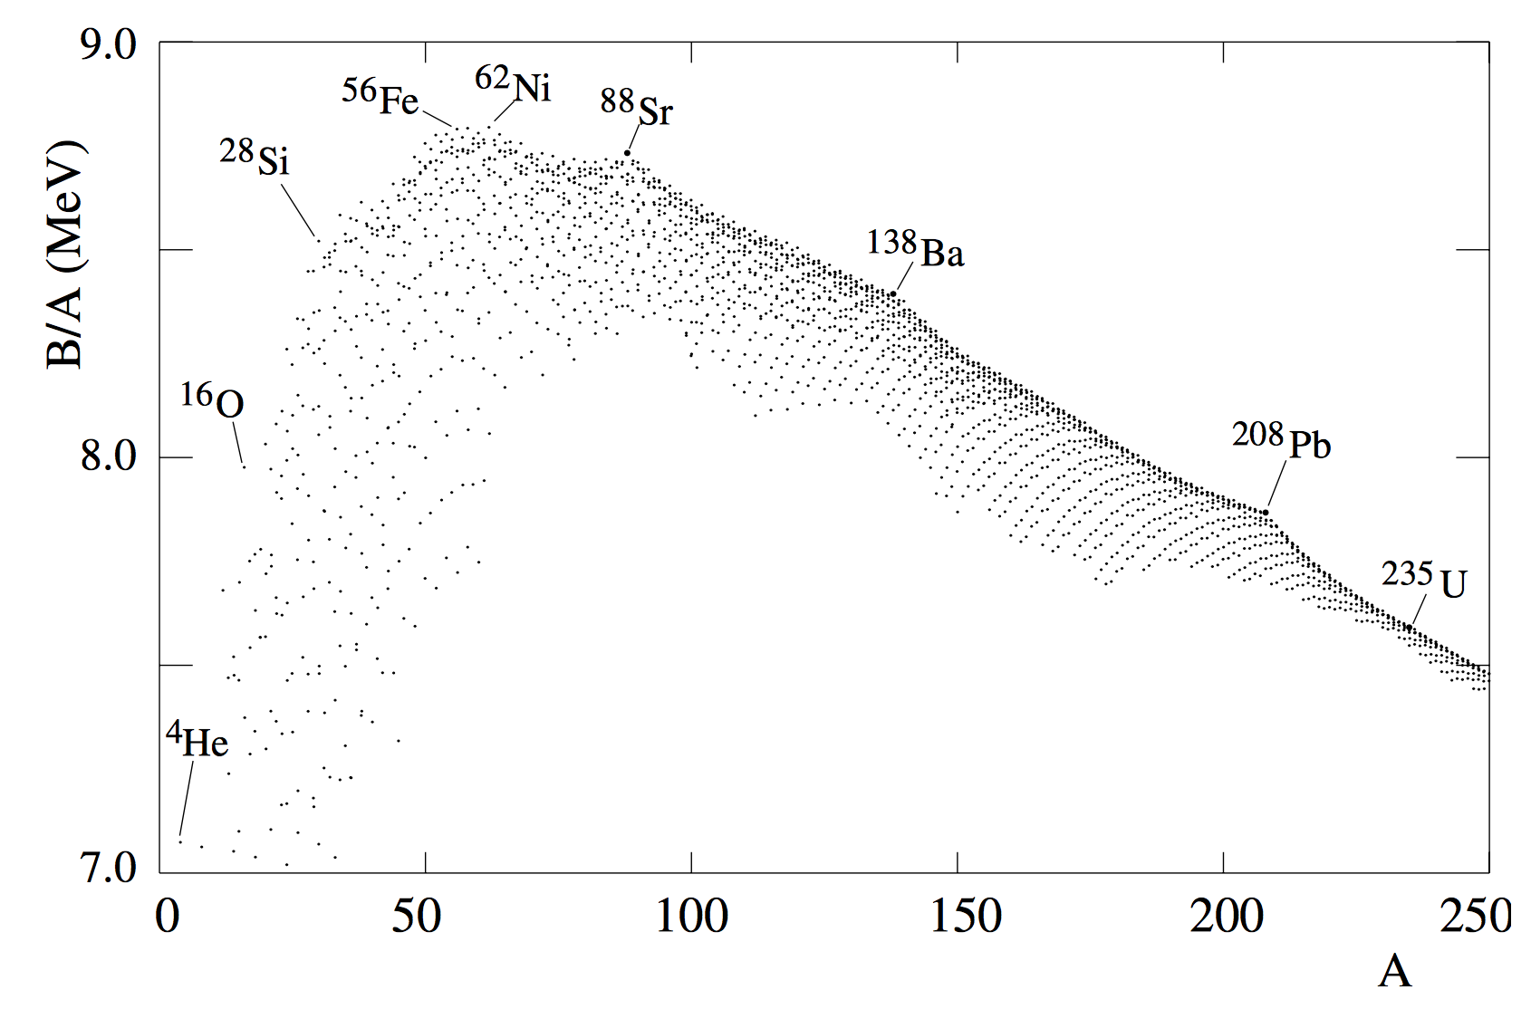
Nuclear Fusion
It is seen that the intermediate-mass nuclei around iron are most tightly bound.
We observe that E_{B}/A increases with A in light nuclei, and reaches a broad maximum around A ~55 − 60 in the iron-nickel region. Beyond, it decreases slowly as a function of A. This tells us that energy can be released by the “fusion” of light nuclei into heavier ones, or by the “fission” of heavy nuclei into lighter ones.
7.7MeV < E_{B}/A < 8.8MeV 12 < A < 225.

Slide 7
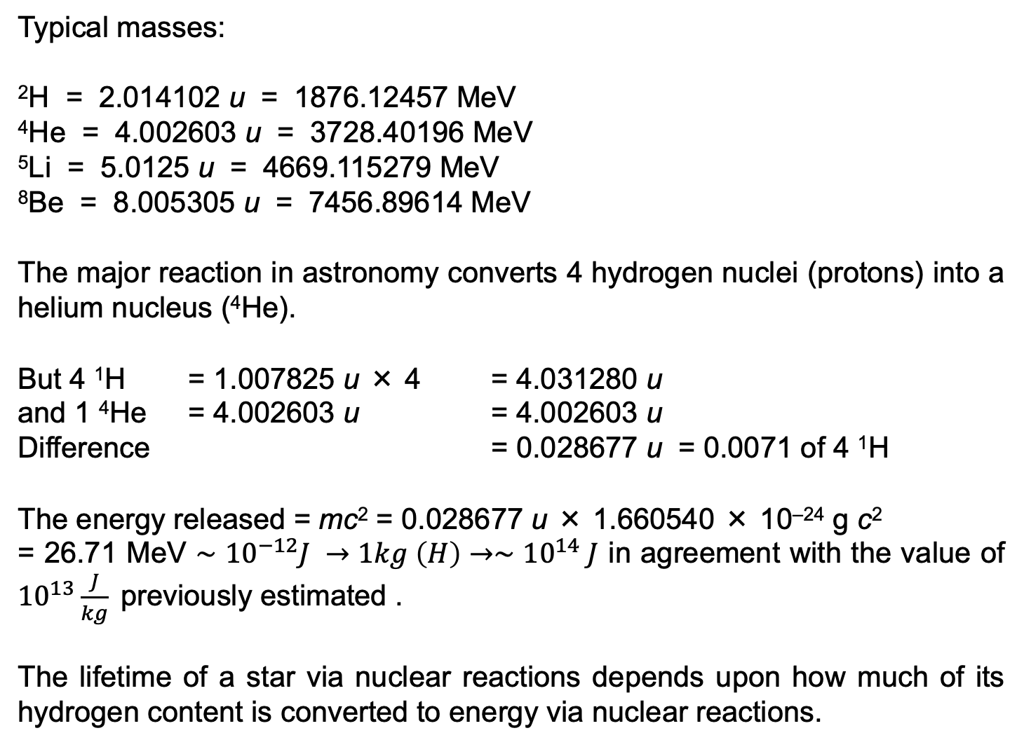
Energy Production
Typical masses:
²H = 2.014102 u = 1876.12457 MeV
⁴He = 4.002603 u = 3728.40196 MeV
⁵Li = 5.0125 u = 4669.115279 MeV
⁸Be = 8.005305 u = 7456.89614 MeV
The major reaction in astronomy converts 4 hydrogen nuclei (protons) into a helium nucleus (⁴He).
But 4 ¹H = 1.007825 u × 4 = 4.031280 u
and 1 ⁴He = 4.002603 u = 4.002603 u
Difference = 0.028677 u = 0.0071 of 4 ¹H
The energy released = mc² = 0.028677 u × 1.660540 × 10^{–24} g c²
= 26.71 MeV $∼{10}^{−12}J →1kg \left(H\right)→∼{10}^{14} J$ in agreement with the value of ${10}^{13}\frac{J}{kg}$previously estimated .
The lifetime of a star via nuclear reactions depends upon how much of its hydrogen content is converted to energy via nuclear reactions.

Slide 8
Nuclear Reaction
We have shown that nuclear reactions can provide the necessary energy to power the stars (and therefore the Sun).
However, to understand the rate at which energy is being produced from nuclear reactions (required in order to get an equation to solve for the star’s luminosity) we need an understanding of the probability that a particular nuclear reaction actually occurs.
This will depend on the stellar conditions in which these reactions occur: density, temperature, abundances of interacting particles.

Slide 9
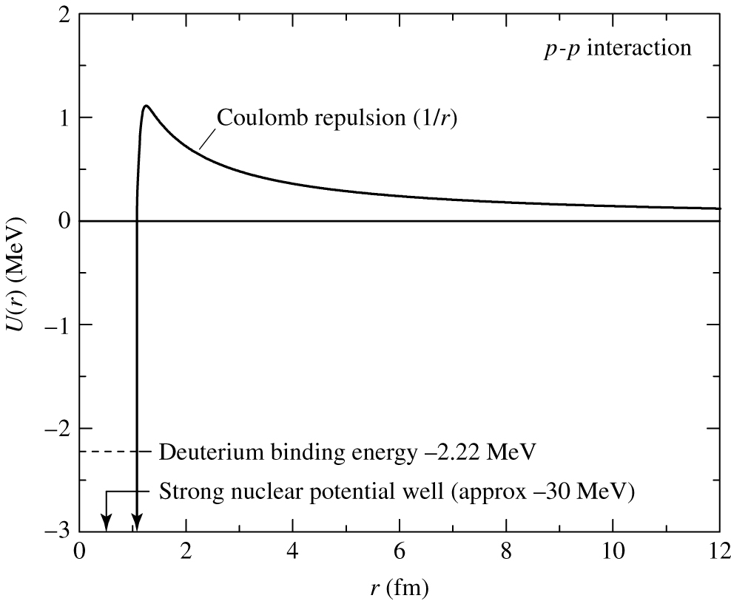
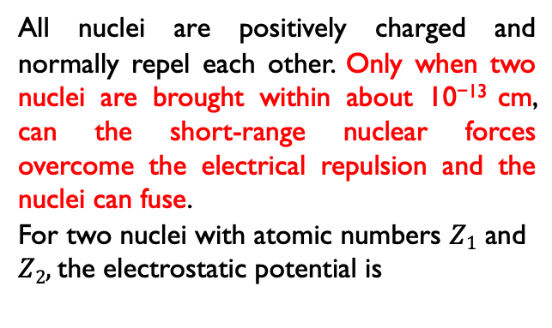
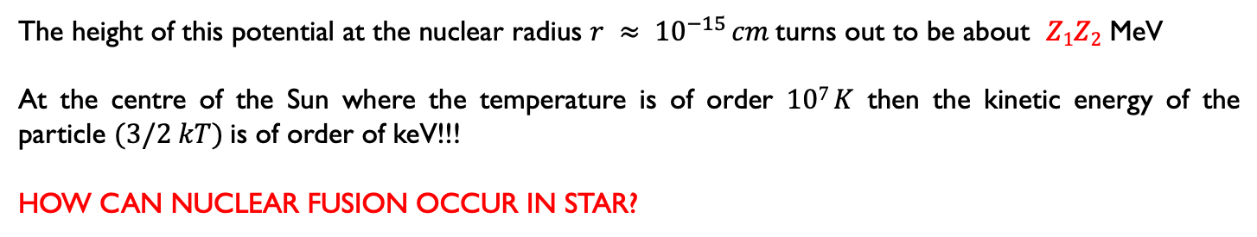
Nuclear Reaction: Quantum tunneling
All nuclei are positively charged and normally repel each other. Only when two nuclei are brought within about 10⁻¹³ cm, can the short-range nuclear forces overcome the electrical repulsion and the nuclei can fuse.
For two nuclei with atomic numbers $Z1$ and
$Z2,$the electrostatic potential is
The height of this potential at the nuclear radius $r ≈ {10}^{−15} cm$turns out to be about $Z1Z2$ MeV
At the centre of the Sun where the temperature is of order $107 K$ then the kinetic energy of the particle $(3/2 kT)$is of order of keV!!!
HOW CAN NUCLEAR FUSION OCCUR IN STAR?

Slide 10
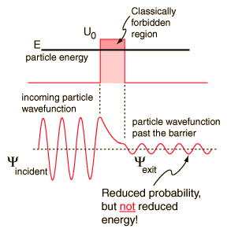
Nuclear Reaction: Quantum tunneling
As derived by Quantum Mechanics, there is a finite probability for a particle to penetrate the Coulomb barrier as if “tunnel” existed.
First used to explain alpha decay of heavier elements in 1928 by George Gamow
Shown experimentally by Leona Esaki in 1958 in the tunneling diode
Consequence of the wave nature of matter. Classically, when a particle is incident on a barrier of greater energy than the particle, reflection occurs.
When described as a wave, the particle has a probability of existing within the barrier region, and even on the other side of it.

Slide 11

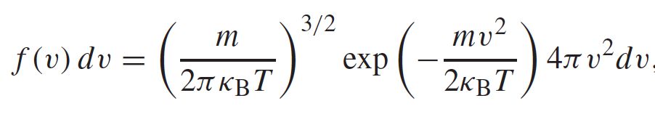
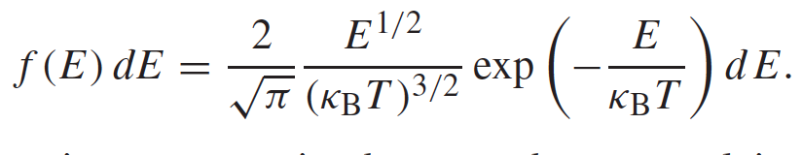
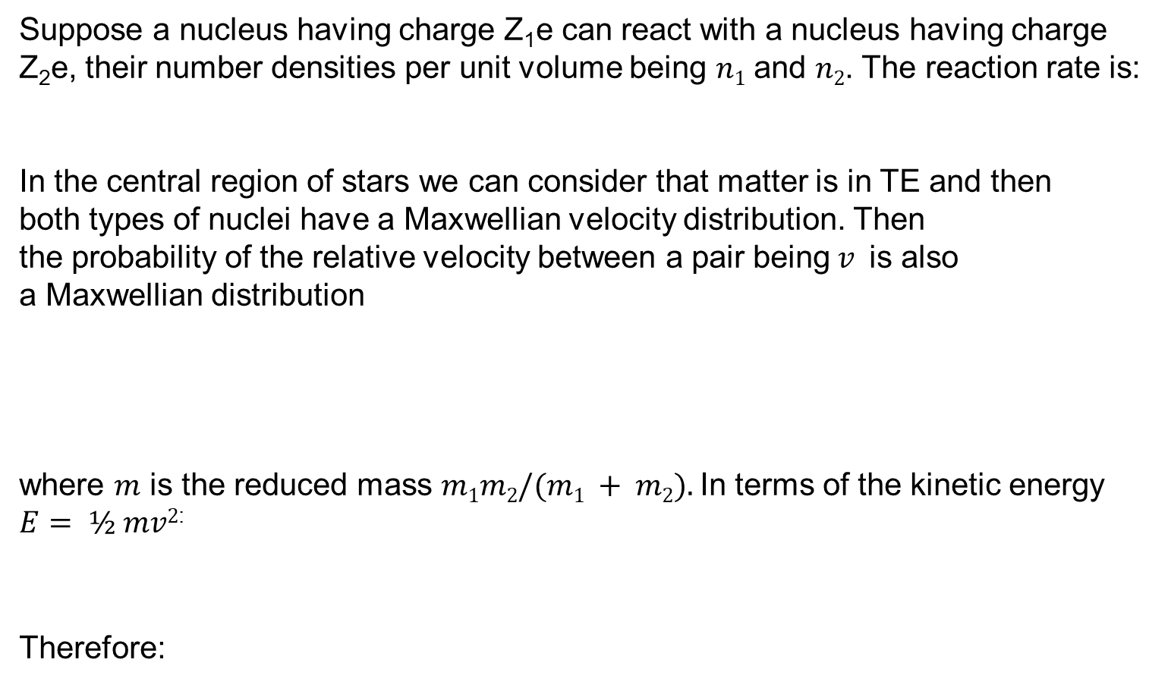
Nuclear Reaction: Reaction rate in stars
Suppose a nucleus having charge Z₁e can react with a nucleus having charge
Z₂e, their number densities per unit volume being $n1$ and $n2$. The reaction rate is:
In the central region of stars we can consider that matter is in TE and then
both types of nuclei have a Maxwellian velocity distribution. Then
the probability of the relative velocity between a pair being$v$is also
a Maxwellian distribution
where $m$ is the reduced mass $m1m2/(m1 + m2).$In terms of the kinetic energy
$E= ½ mv2$:
Therefore:

Slide 12
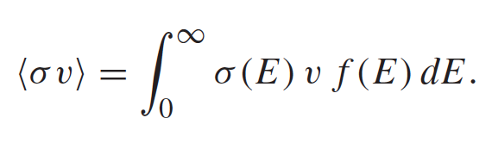
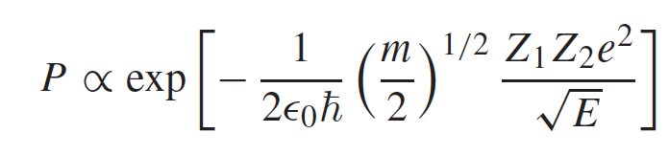
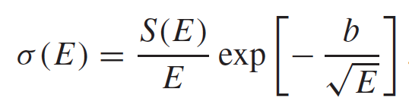
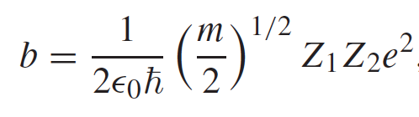
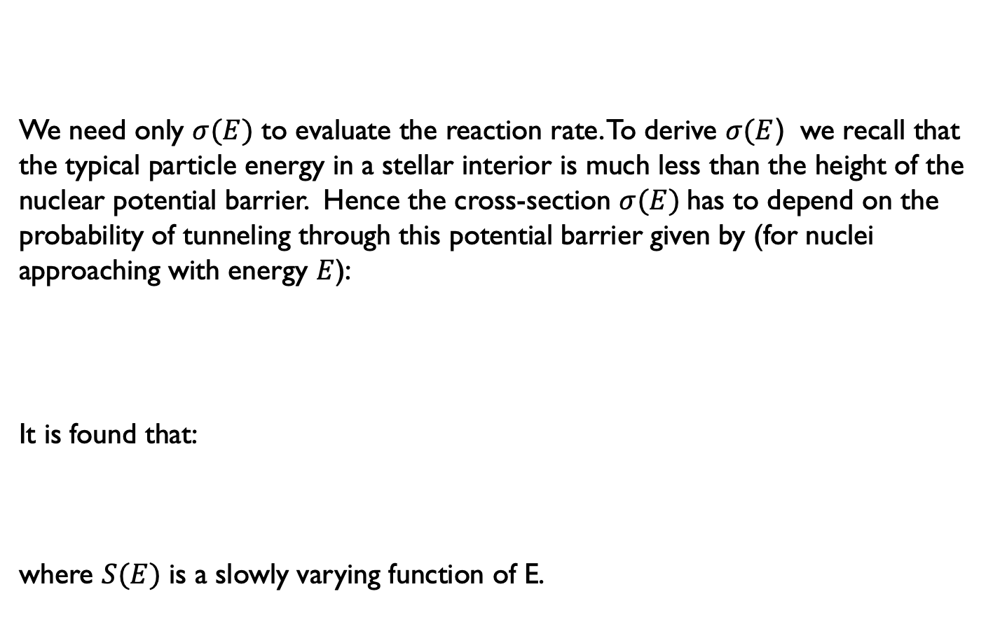
Nuclear Reaction: Reaction rate in stars
We need only $σ(E)$ to evaluate the reaction rate. To derive $σ(E$) we recall that the typical particle energy in a stellar interior is much less than the height of the nuclear potential barrier. Hence the cross-section $σ(E)$has to depend on the probability of tunneling through this potential barrier given by (for nuclei approaching with energy $E$):
It is found that:
where $S(E)$ is a slowly varying function of E.

Slide 13
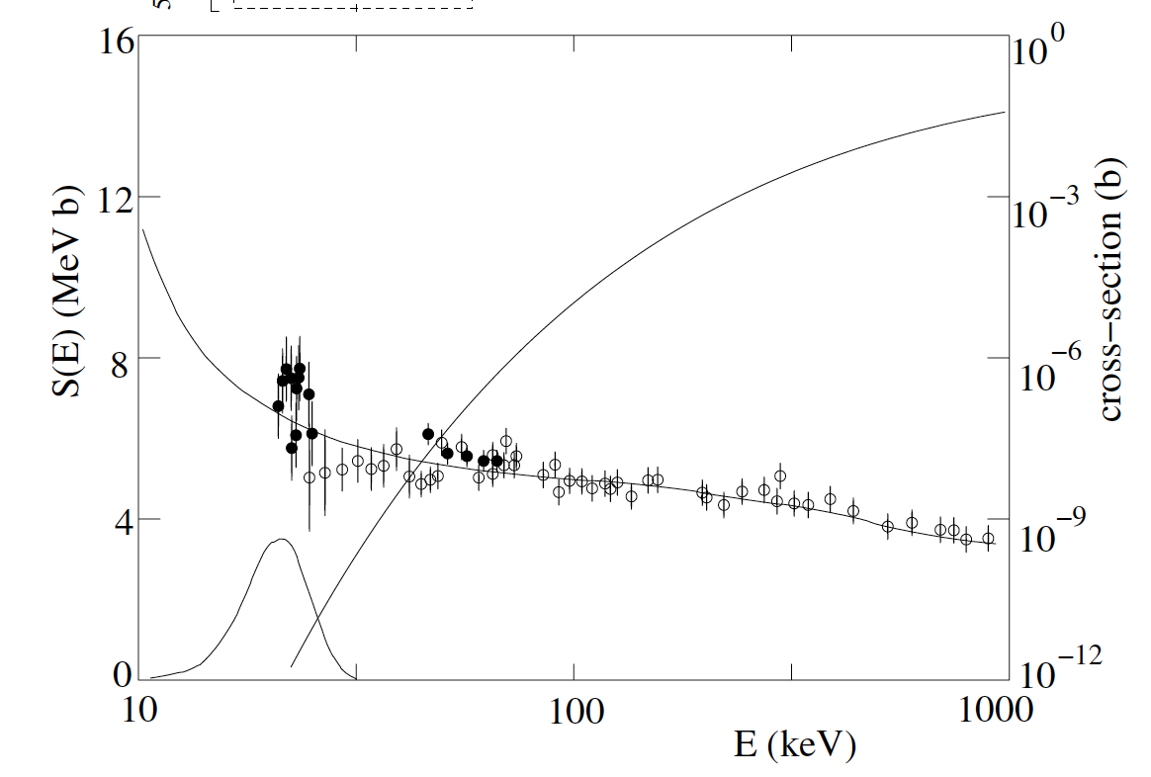
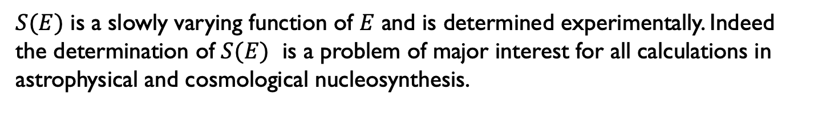

Nuclear Reaction: Reaction rate in stars
$S(E)$ is a slowly varying function of $E$ and is determined experimentally. Indeed the determination of $S(E)$ is a problem of major interest for all calculations in astrophysical and cosmological nucleosynthesis.
Cross-section and S(E) for $3He + 3He →4He+p+p$, as measured by the LUNA underground accelerator facility (INFN-Gran Sasso)

Slide 14
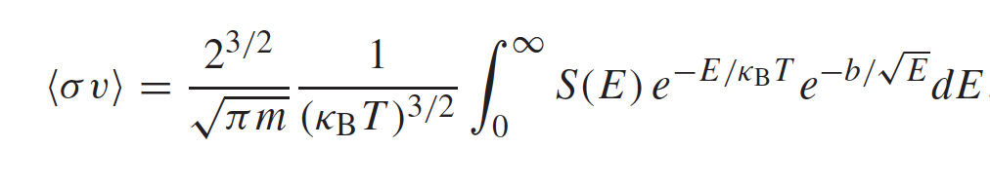


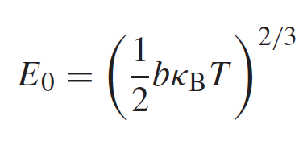
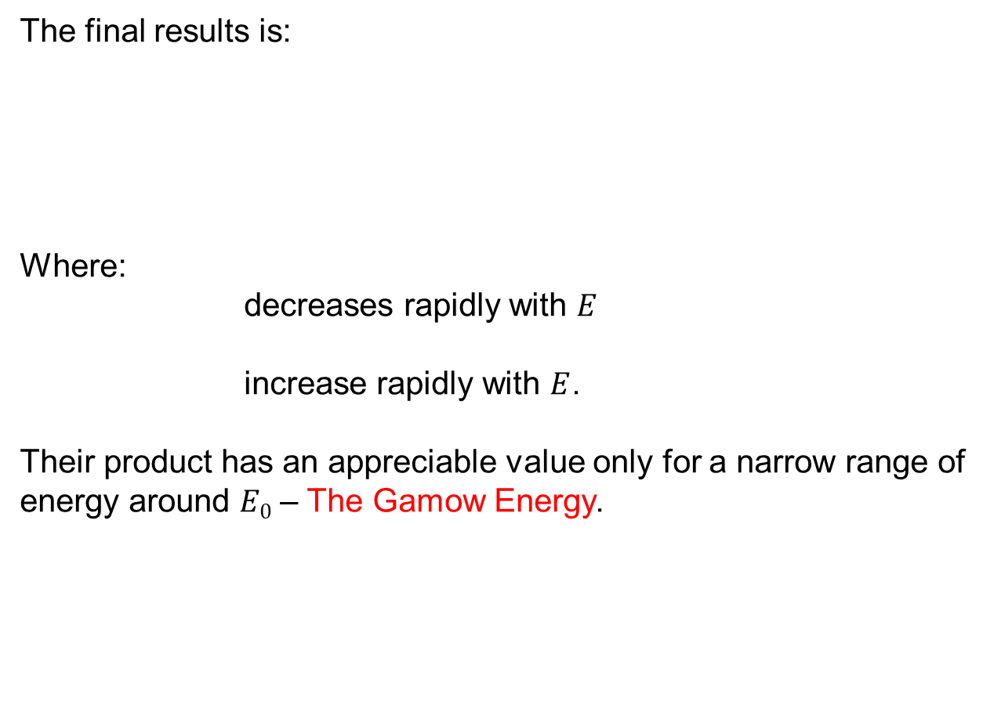
Nuclear Reaction: Reaction rate in stars
The final results is:
Where:
decreases rapidly with $E$
increase rapidly with $E$.
Their product has an appreciable value only for a narrow range of energy around $E0$ – The Gamow Energy.

Slide 15
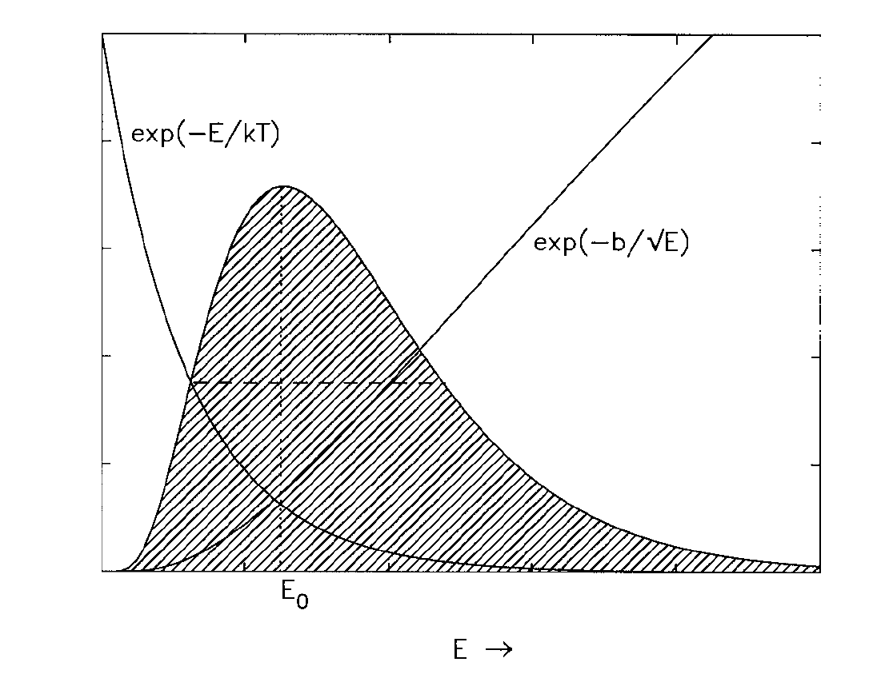
Nuclear Reaction: The Gamow peak
Most fusion reactions take place between particles with relative energies lying within the Gamow peak. The area under the Gamow peak determines the reaction rate.

Slide 16
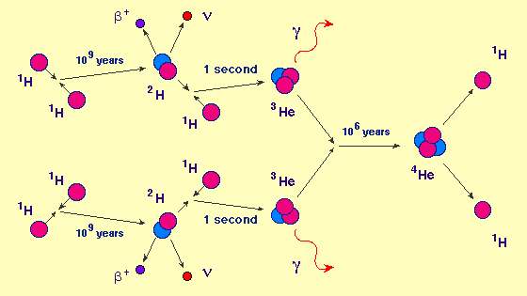
Le Reazioni Nucleari possibili: Proton-proton chain (PPI)
Il primo passo della catena è il più lento in quanto si deve avere
Nel Sole questo processo è quello più attivo (69%).

Slide 17
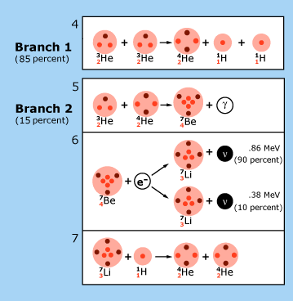
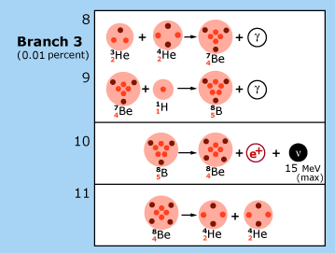
Le Reazioni Nucleari possibili: Proton-proton chain (PPII & PPIII)
PPII
Nel Sole (31%)
PPIII
Nel Sole (0.3%)

Slide 18
Catena p-p
La rate di produzione di energia complessiva per tutti e tre I rami della catena PP è:
A T~1.5x10⁷ K (Temperatura al centro del Sole):

Slide 19
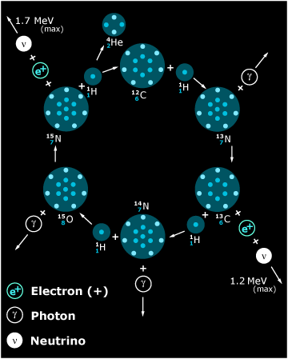
Il ciclo CNO
( 99.6% delle reazioni )
A T~1.5x10⁷ K

Slide 20
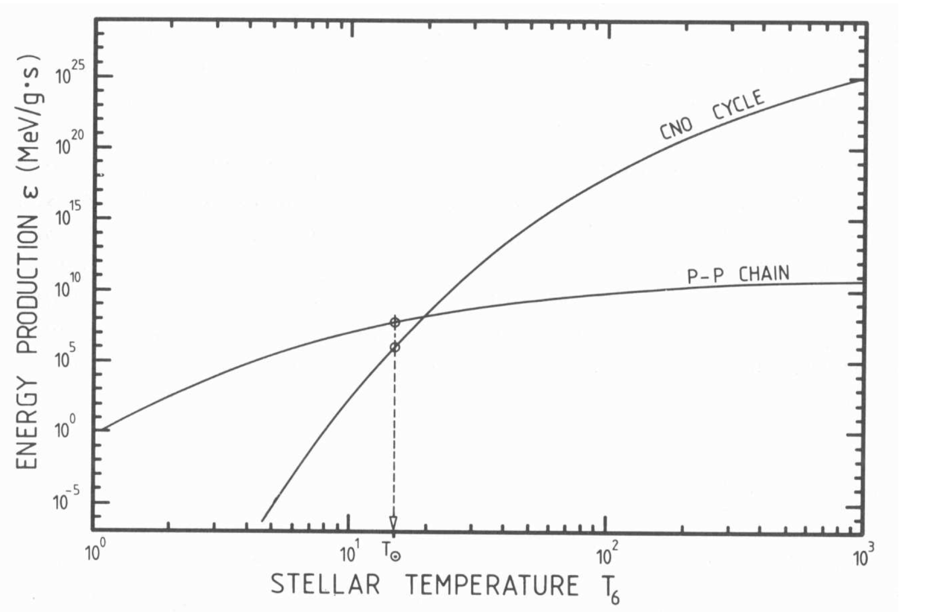
p-p chain vs CNO Cycle

Slide 21
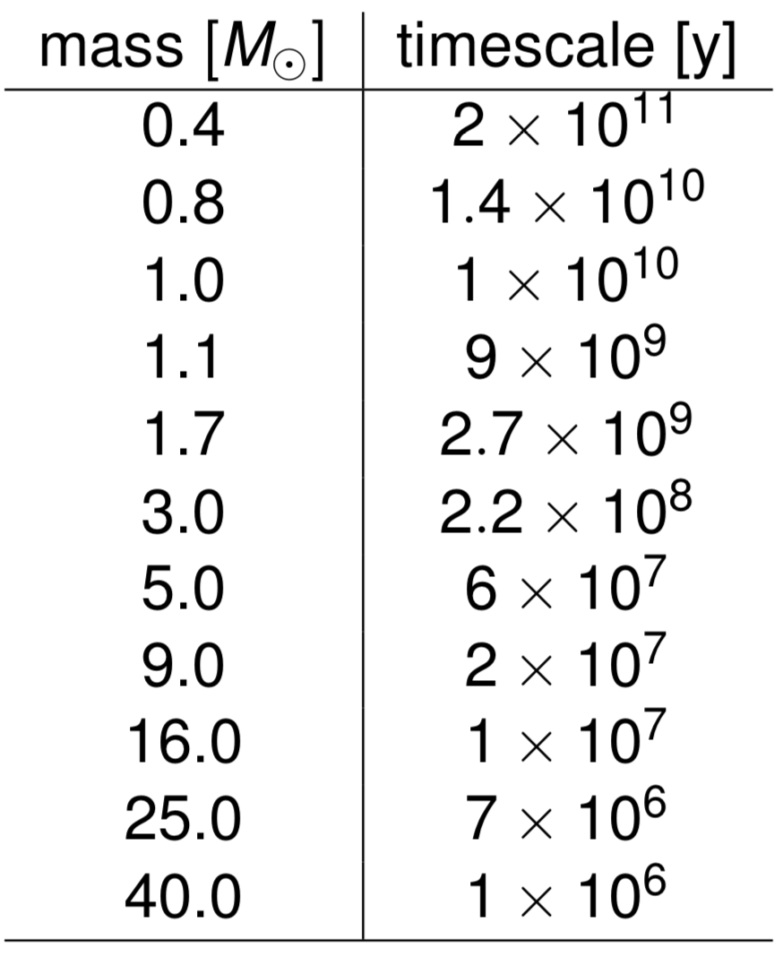
Timescale of the H-burning
Stars heavier than the Sun burn hydrogen via CNO cycle
CNO Cycle goes significantly faster –> shorter lifetimes
Hydrogen burning timescales depend strongly on mass

Slide 22
Nucleosintesi degli elementi nell’Universo
Uno dei principali obiettivi dell’astrofisica nucleare è spiegare le abbondanze degli elementi nell’Universo.
Si pensa che L’elio sia stato prodotto già nelle fasi iniziali dell’Universo e a questo si è poi aggiunto quello sintetizzato nelle stelle.
Rimane da spiegare come si sono poi formati gli elementi più pesanti.
La spiegazione risiede nell’analisi di quali sono tutte le possibili reazioni nucleari che possono avvenire nelle stelle. (Burbidge, E. M., Burbidge, G. R., Fowler, W. A. and Hoyle, F. 1957, Rev. Mod. Phys.29 , 547)
Cominciamo a vedere quelle che possono portare alla formazione degli elementi fino al ferro.

Slide 23
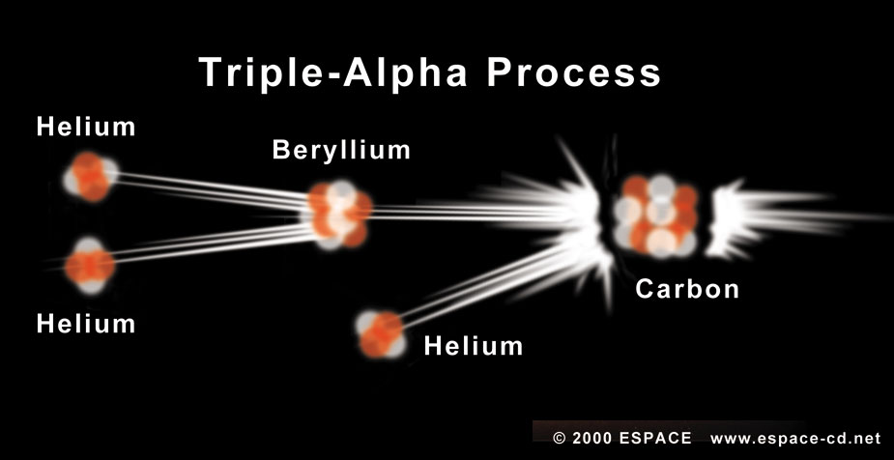
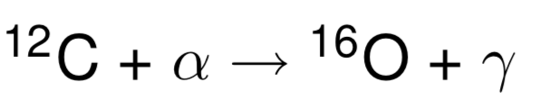
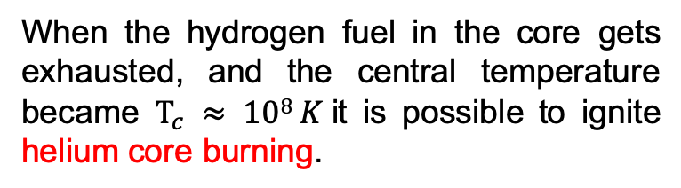
He- Burning: triple-alpha process
When the hydrogen fuel in the core gets exhausted, and the central temperature became $T_{c} ≈ 108 K$it is possible to ignite helium core burning.
An increase of 10% of T increase of a factor 50 the energy generation rate.
The ¹²C can then react with another He nucleus and form ¹⁶O

Slide 24

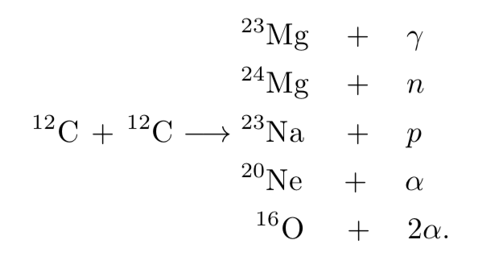

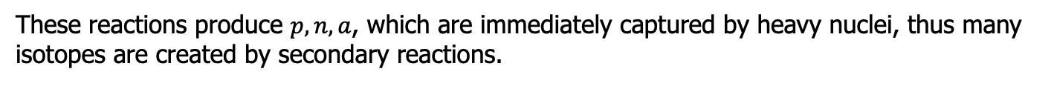
After the He-burning: Carbon burning
Stars with can ignite $Carbon burning$. Carbon starts to burn when the temperatures reach $5 × 108 K$. There are several channels of carbon burning:
The overall energy generation is about $5.2 × 1017$erg g^{−1.}
These reactions produce $p, n, a$, which are immediately captured by heavy nuclei, thus many isotopes are created by secondary reactions.

Slide 25
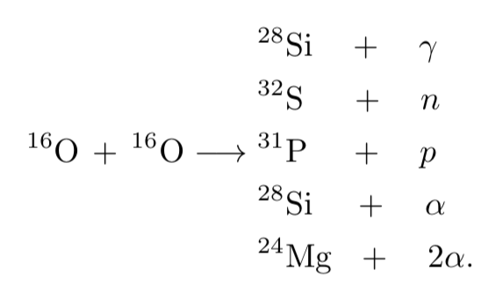
After C-burning: Oxygen burning
The process of oxygen burning ignites at a temperature of 10⁹ K. Similar to ¹²C, there are several channels available:
The overall energy generation is about 4.7 × 10¹⁷ erg g^{−1.}
These reactions produce p, n, α, which are immediately captured by heavy nuclei, thus many isotopes are created by secondary reactions.

Slide 26
Silicon burning: nuclear statistical equilibrium
Silicon burning follows the oxygen burning and is the final advanced burning stage that releases energy. The temperature of silicon burning is about 3 ×10⁹ K.
In such high temperatures, energetic photons are able to disintegrate the heavy nuclei; this process is called photodisintegration.
During the silicon burning:
part of the silicon is first photodisintegrated
the light isotopes are then recaptured by the silicon
the resulting isotopes are photodisintegrated recursively.
Such reactions build up a reaction network and tend to reach a status called nuclear statistical equilibrium (NSE): the forward and backward reaction rates in NSE are almost equal.
A perfect NSE occurs only at temperatures > 7 × 10⁹ K.
At the end, silicon burns into the iron group, including iron, cobalt, and nickel, and no more energy can be released from burning these isotopes

Slide 27
Major nuclear burning processes
Nuclear Fuel | Process | T_{threshold} 10⁶K | Products | Energy per nucleon (Mev)
H | PP | ~4 | He | 6.55
H | CNO | 15 | He | 6.25
He | 3α | 100 | C,O | 0.61
C | C+C | 600 | O,Ne,Ma,Mg | 0.54
O | O+O | 1000 | Mg,S,P,Si | ~0.3
Si | Nuc eq. | 3000 | Co,Fe,Ni | <0.18
However, not every star goes through all of these burning processes; it depends on their initial masses.

Slide 28
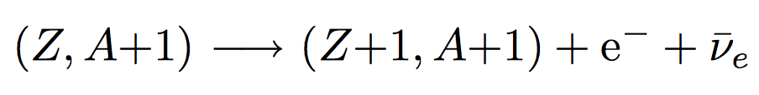
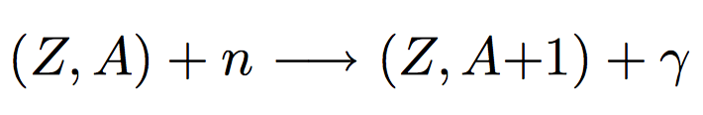
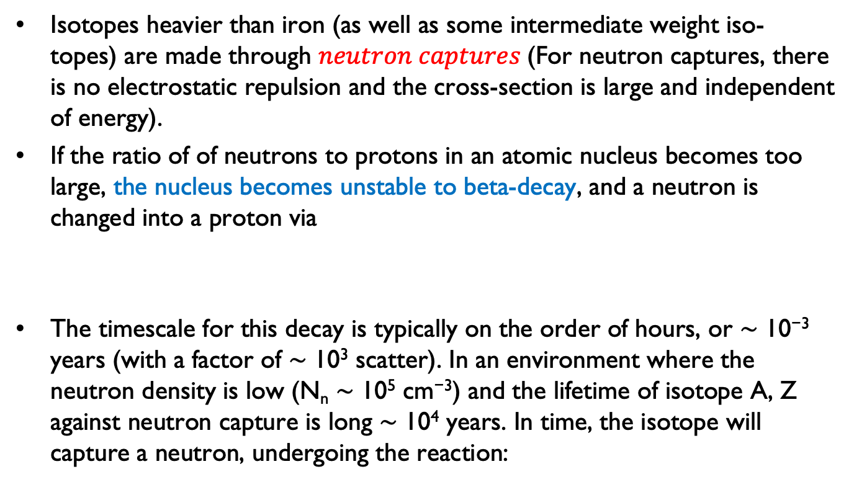
Formation of the Heavier Elements
Isotopes heavier than iron (as well as some intermediate weight iso- topes) are made through $neutron captures$(For neutron captures, there is no electrostatic repulsion and the cross-section is large and independent of energy).
If the ratio of of neutrons to protons in an atomic nucleus becomes too large, the nucleus becomes unstable to beta-decay, and a neutron is changed into a proton via
The timescale for this decay is typically on the order of hours, or ∼ 10⁻³ years (with a factor of ∼ 10³ scatter). In an environment where the neutron density is low (N_{n} ∼ 10⁵ cm⁻³) and the lifetime of isotope A, Z against neutron capture is long ∼ 10⁴ years. In time, the isotope will capture a neutron, undergoing the reaction:

Slide 29


Equazione della produzione di energia
Se in ogni reazione è rilasciata una quantità di energia L, la quantità di energia rilasciata per unità di massa risulta:
Quindi la somma di tutte le reazioni ( ) ) che avvengono nella stella generano una luminosità:
Questa è la 4° Equazione da considerare nel calcolo di una struttura stellare. In generale con il termine dovuto alla gravità trascurabile.

Slide 30
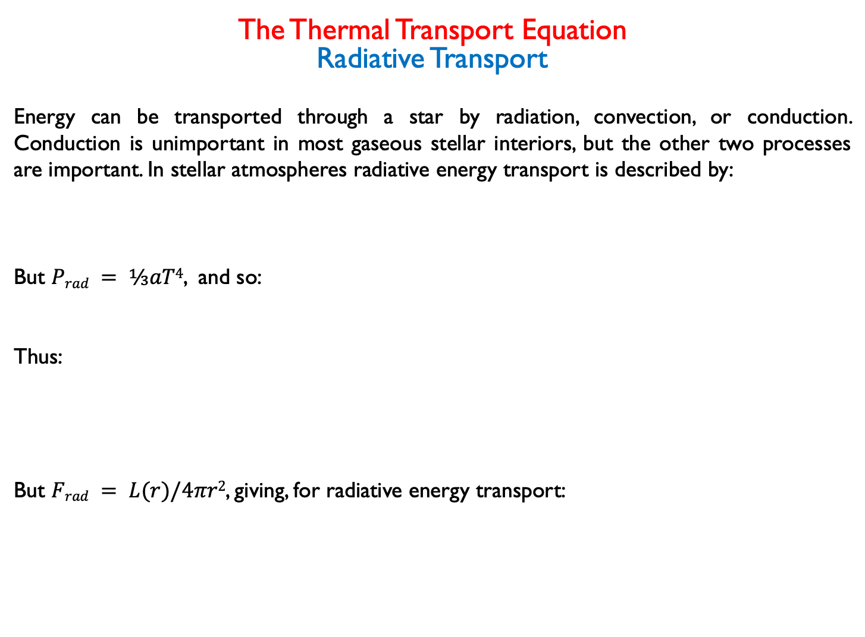

The Thermal Transport Equation
Radiative Transport
Energy can be transported through a star by radiation, convection, or conduction. Conduction is unimportant in most gaseous stellar interiors, but the other two processes are important. In stellar atmospheres radiative energy transport is described by:
But $Prad = ⅓aT4$, and so:
Thus:
But $Frad = L(r)/4πr2$, giving, for radiative energy transport:
$$α=κρ$$

Slide 31
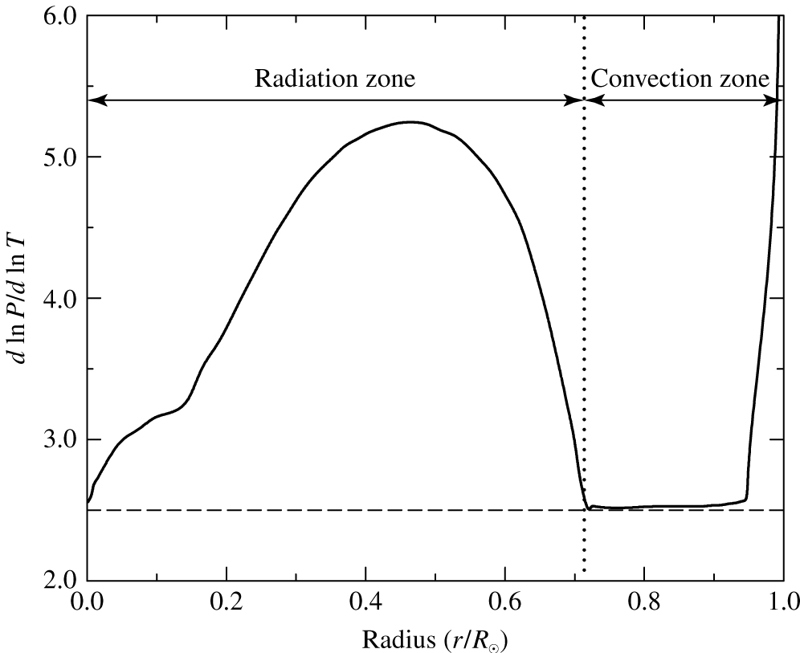
Trasporto di energia nel Sole
Si trova che se dlnP/dlnT > 2.5 il metodo più efficiente è quello radiativo.

Slide 32
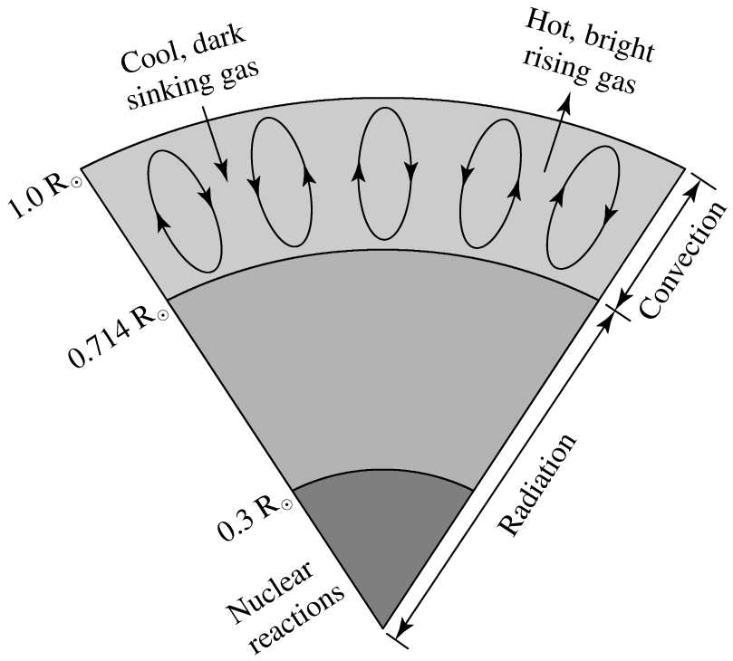
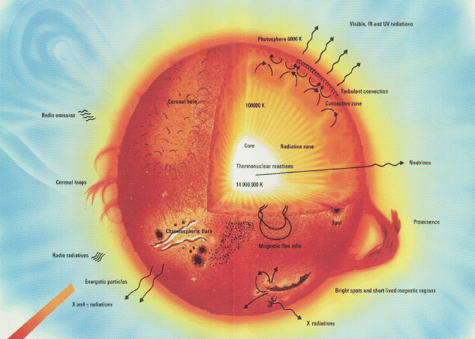
L’Interno del Sole
Esistono tre regioni nel Sole

Slide 33
Equations of a Static Stellar Structure
Equilibrio idrostatico
Conservazione della Massa:
Conservazione dell’energia
Radiazione
Trasporto dell’ Energia:
Convezione
Equazione di Stato

Slide 34
Equation of a Static Stellar Structure
The parameters used for studying and modeling stellar interiors include:
r = radial distance from the centre of the star
M(r) = mass interior to r
T(r) = temperature at r
P(r) = pressure at r
L(r) = luminosity at r
ε(r) = energy generation at r
κ(r) = opacity at r
ρ(r) = density at r
In modern models mass M is used as the dependent variable rather than radial distance r, but at this level is more intuitive to study the stellar interiors using the geometrical variable r.

Slide 35
Equation of a Static Stellar Structure
At the boundaries of the star the corresponding values are:
At the centre: At the surface:
r = 0 r = R
M(r) = 0 M(r) = M*
T(r) = T_{c} T(r) = 0 (or T_{eff})
P(r) = P_{c} P(r) = 0
L(r) = L_{c} L(r) = L*
ρ(r) = ρ_{c} ρ(r) = 0
Note: Rotation and magnetic fields are usually ignored in most models (i.e. spherical symmetry is imposed), as well as any temporal changes (i.e. radial pulsation).

Slide 36
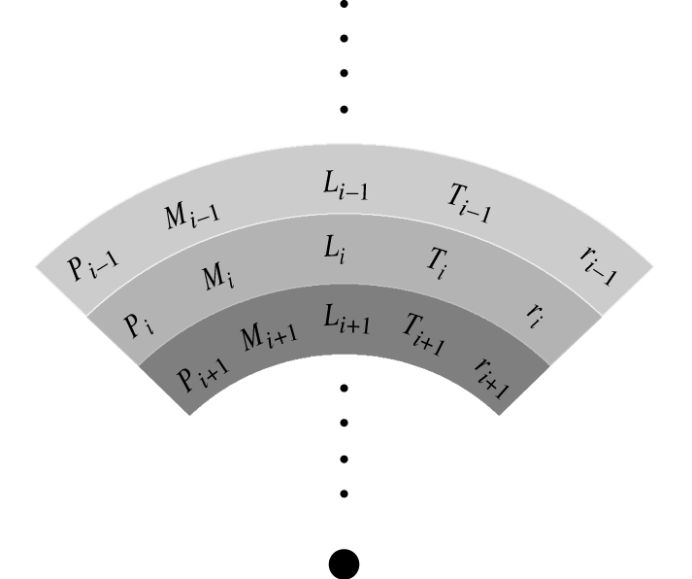
Stellar Models
Models are constructed numerically using the differential equations as difference equations. They are also rearranged so that the dependent variable is mass rather than radius.
Models are then denoted by the number of mass cells they contain. Spherical symmetry is also assumed, although that assumption is relaxed in more recent models.

Slide 37
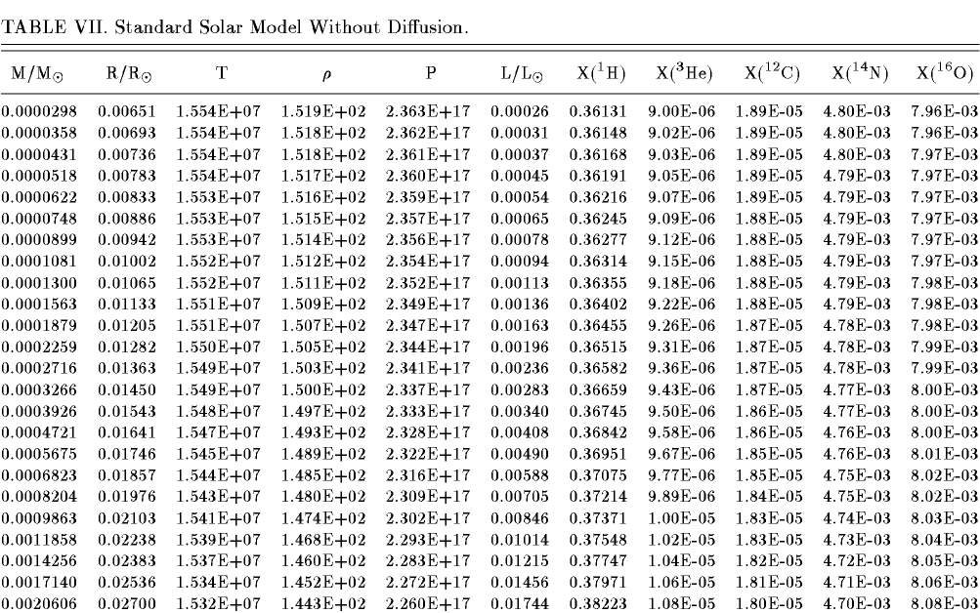
Stellar Models

Slide 38
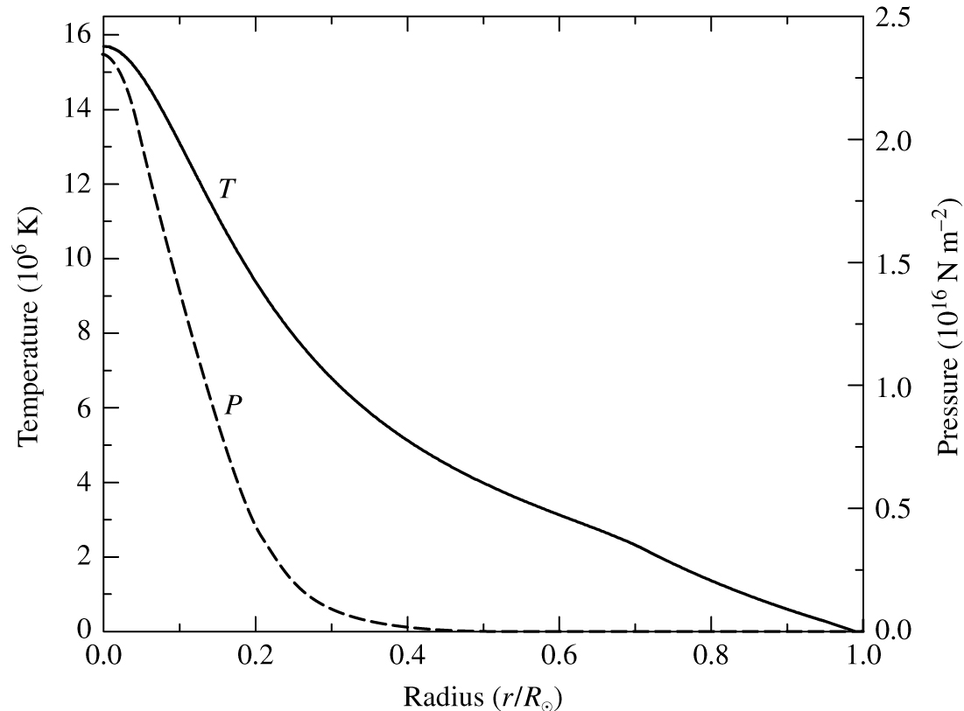
Il Modello Solare
(Temperature and Pressure)

Slide 39
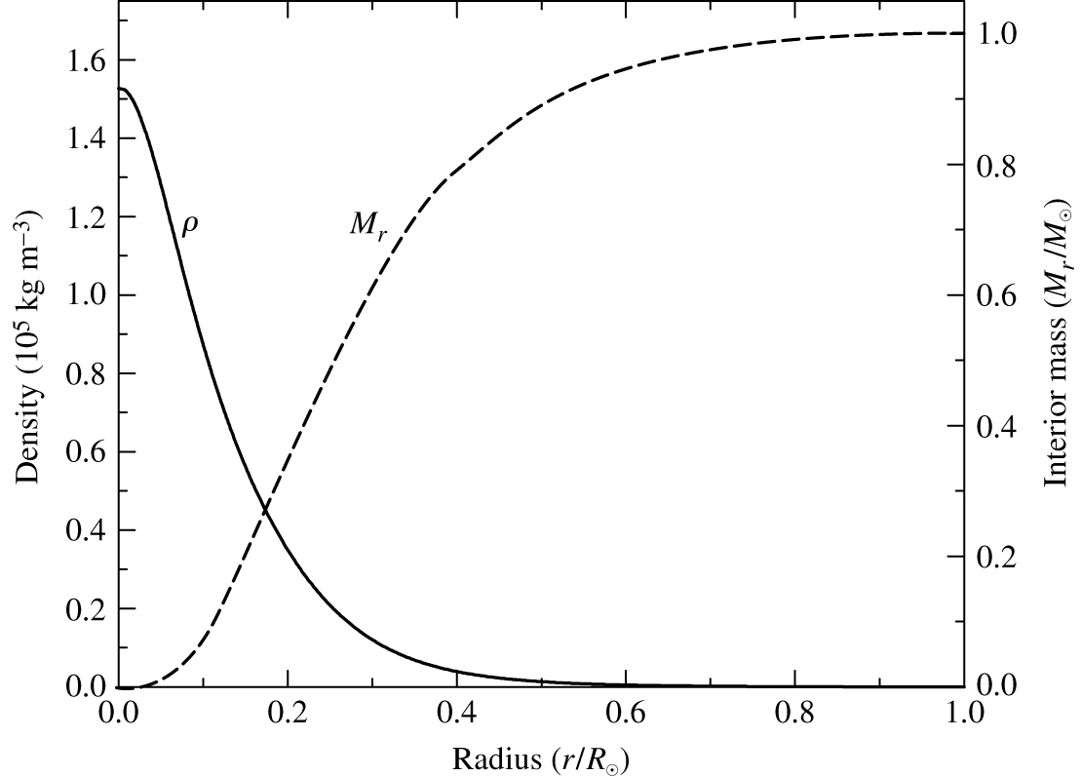
Il Modello Solare
(Density and Mass)

Slide 40
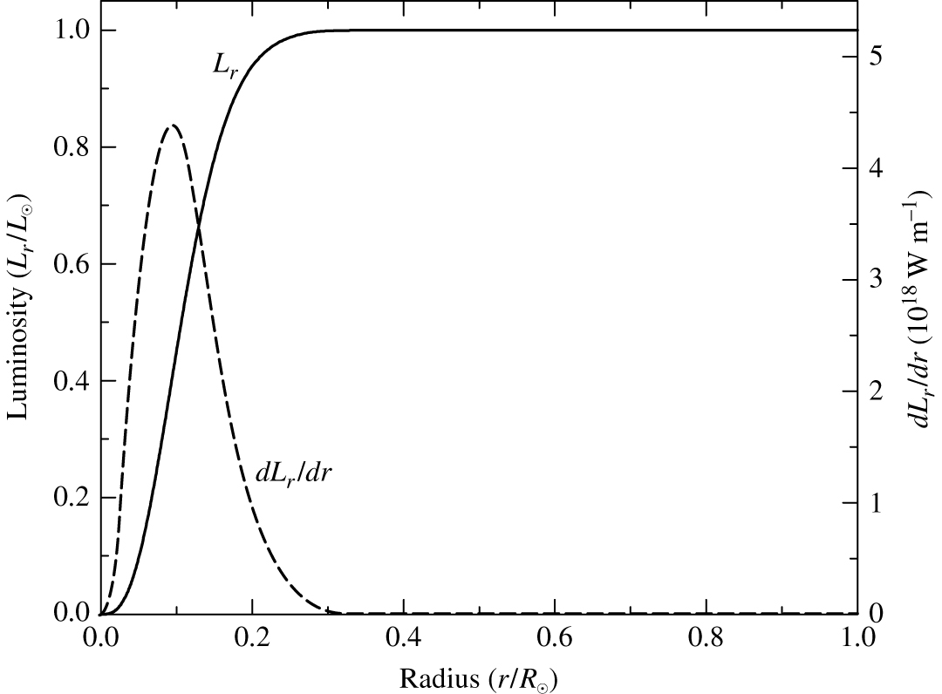
Distribuzione della Luminosità prodotta
(Luminosity)
Il massimo si ha intorno a 0.1 R

Slide 41
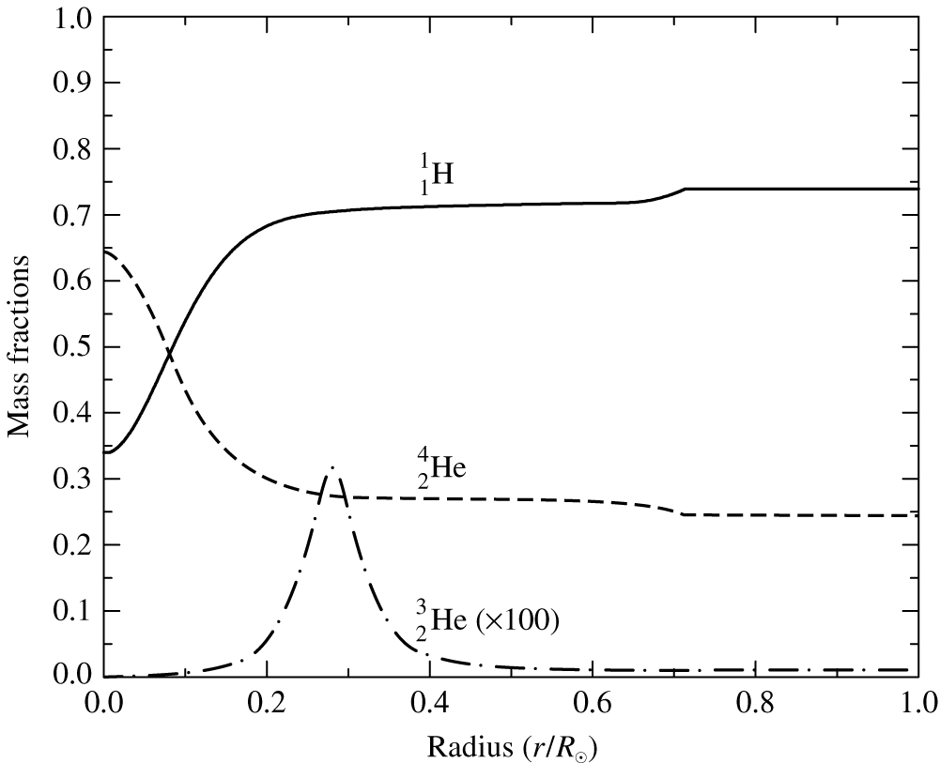
Distribuzione degli elementi nel Sole

Slide 42
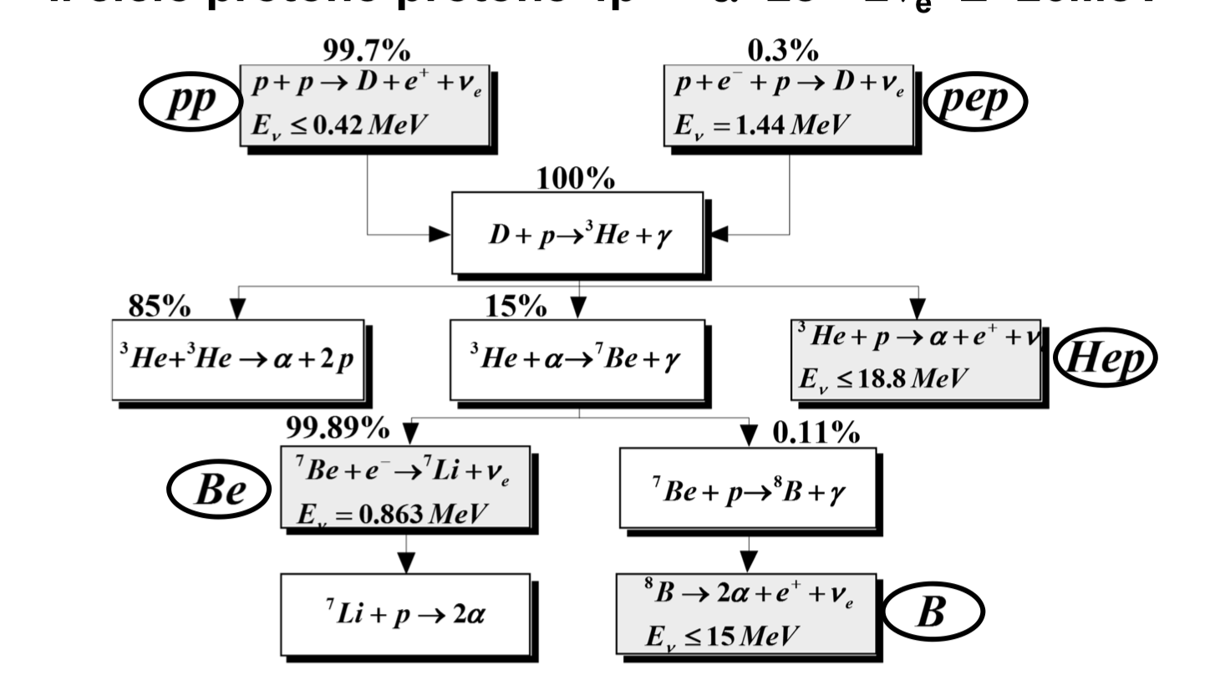
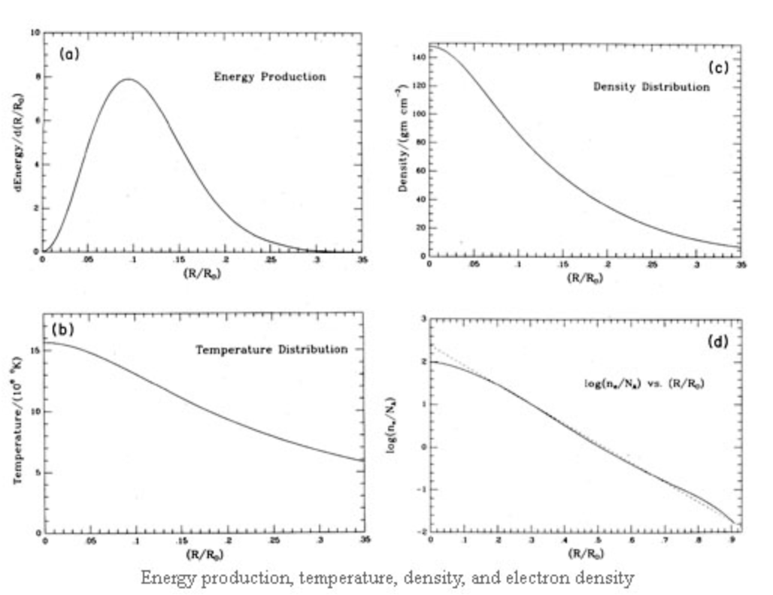
Osservazione Diretta del Core Solare: I neutrini
Abbiamo visto che nel Sole la principale fonte di energia è data dalla catena p-p.
L’energia media dei neutrini solari è <1 MeV (= 1.6 x 10⁻¹³ J) around 0.2 MeV.
La sezione d’urto per lo scattering dei neutrini con la materia è dell’ordine di 10⁻⁴⁴ cm² e quindi il cammino libero medio di un neutrino è:
Quindi i neutrini sfuggono dal Sole senza interagire [ ]

Slide 43
Osservazione Diretta del Core Solare: I neutrini
Il flusso totale di neutrini previsto sulla Terra può essere stimato considerando che la reazione
Produce un’energia E_{pp}~ 26 MeV. Quindi il flusso di neutrini è:
Con:
Si ottiene:

Slide 44

Osservazione Diretta del Core Solare: I neutrini
Una stima accurata del flusso totale di neutrini previsto sulla Terra è:
spettro atteso è:
Difficili da rivelare. La rate di interazione (pur dipendente dal tipo di materia bersaglio) è dell’ordine di 10⁻⁴ interazioni al secondo per 1000 kg di materia!

Slide 45


Il problema dei neutrini solari
Gli esperimenti hanno misurato un numero di neutrini inferiore a quanto previsto.
Attualmente, si ritiene, che i neutrini possiedono una massa e che possono cambiare “flavour” (sapore) prima di arrivare sulla terra (oscillazione dei neutrini).
Quindi I neutrini mancanti sono quei neutrini elettronici che si sono trasformati in uno degli altri due tipi (tau,mu) lungo il tragitto.
Questo esperimento ha risolto il problema dei neutrini solari. Trovando che solo un 1/3 di neutrini elettronici prodotti rimangono tali i restanti si trasformano in neutrini tau e mu.

